Slide 1
Uncontrollable Rectifier Training set

Slide 2
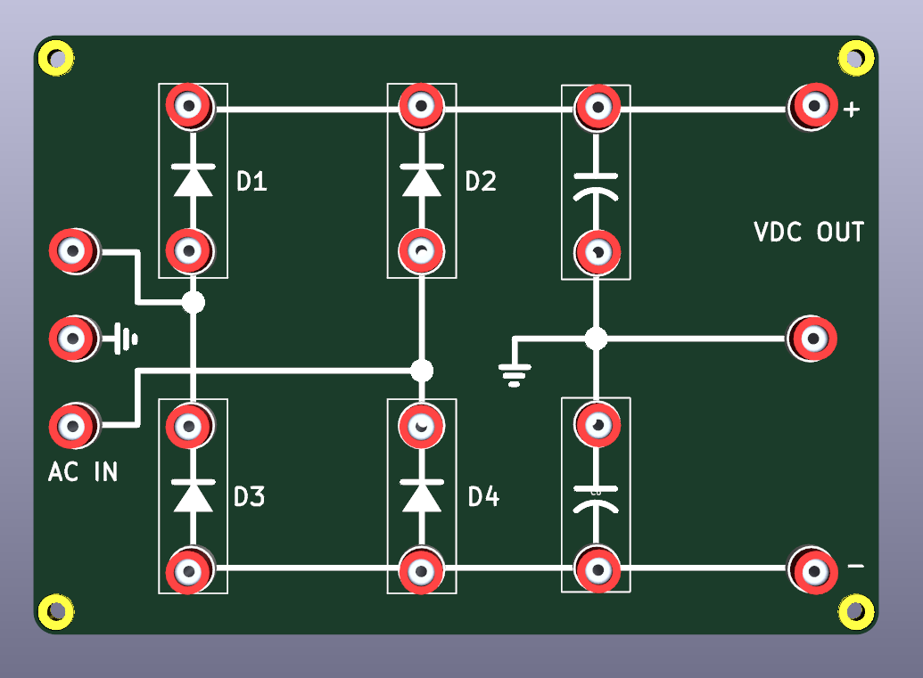





Single pulse (Half wave rectifier)

Slide 3




Single pulse (Half wave rectifier) C-Filter

Slide 4



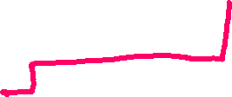



Two pulses (Full wave rectifier)

Slide 5







Two pulses (Full wave rectifier) C-Filter

Slide 6






Two pulses (Bridge rectifier) Positive pulse

Slide 7



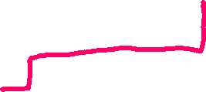


Two pulses (Bridge rectifier) Negative pulse

Slide 8








Two pulses (Dual voltage) Positive pulse

Slide 9

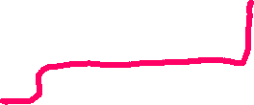






Two pulses (Dual voltage) Negative pulse

